Slide 1
S-8 | SLO-1 | Seven segment Display and A Digital Clock.
 | SLO-2 | Problem solving session

Slide 2
Seven segment Display
A seven-segment display (SSD), or seven-segment indicator, is a form of electronic display device for displaying decimal numerals.
The Seven segment display consists of seven LEDs arranged in a rectangular fashion.
Each of the seven LEDs is called a segment.
Each segment is labelled from “a” to “g”
Display the any one of the decimal digits (0 to 9)
BCD to seven segment decoder accepts a decimal digit in BCD and generate the corresponding

Slide 3
Design Requirements
Design the logic circuitry that will drive a seven segment LED display and will be able to represent numbers from 0 to 9

Slide 4
Possible numbers and their representation on 7 segment display

Slide 5
Truth Table

Slide 6
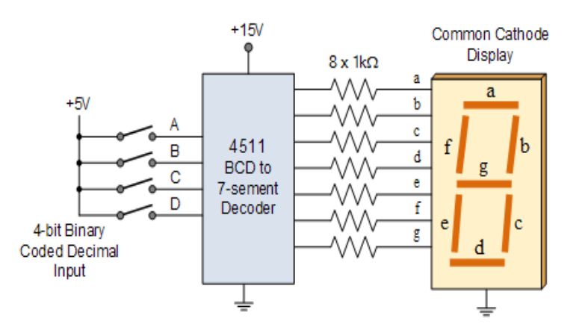
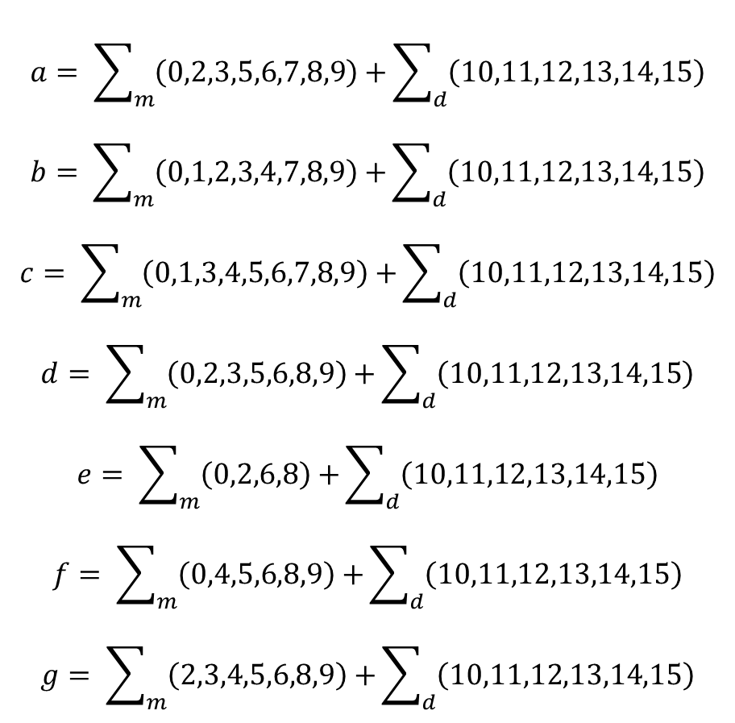
$$a= \sum_{m}{\left(0,2,3,5,6,7,8,9\right)+}\sum_{d}{\left(10,11,12,13,14,15\right)}$$
$$b= \sum_{m}{\left(0,1,2,3,4,7,8,9\right)+}\sum_{d}{\left(10,11,12,13,14,15\right)}$$
$$c= \sum_{m}{\left(0,1,3,4,5,6,7,8,9\right)+}\sum_{d}{\left(10,11,12,13,14,15\right)}$$
$$d= \sum_{m}{\left(0,2,3,5,6,8,9\right)+}\sum_{d}{\left(10,11,12,13,14,15\right)}$$
$$e= \sum_{m}{\left(0,2,6,8\right)+}\sum_{d}{\left(10,11,12,13,14,15\right)}$$
$$f= \sum_{m}{\left(0,4,5,6,8,9\right)+}\sum_{d}{\left(10,11,12,13,14,15\right)}$$
$$g= \sum_{m}{\left(2,3,4,5,6,8,9\right)+}\sum_{d}{\left(10,11,12,13,14,15\right)}$$

Slide 7
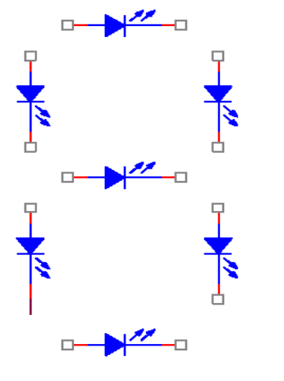
Arrangement of LED inSSD

Slide 8
Types of SSD
The SSD common pin is generally used to identify which type of 7-segment display it is. As each LED has two connecting pins, one called the “Anode” and the other called the “Cathode”, there are therefore two types of LED 7-segment display called: Common Cathode (CC) and Common Anode(CA).
The difference between the two displays, as their name suggests, is that the common cathode has all the cathodes of the 7-segments connected directly together and the common anode has all the anodes of the 7-segments connected together and is illuminated as follows.

Slide 9
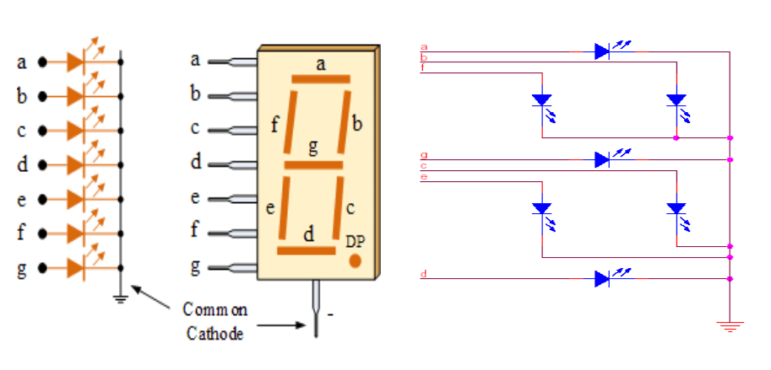
Common cathode SSD

Slide 10
Common Cathode (CC)
In the common cathode display, all the cathode connections of the LED’s are joined together to logic “0” or ground.
The individual segments are illuminated by application of a “HIGH”, logic “1” signal to the individual Anode terminals.

Slide 11
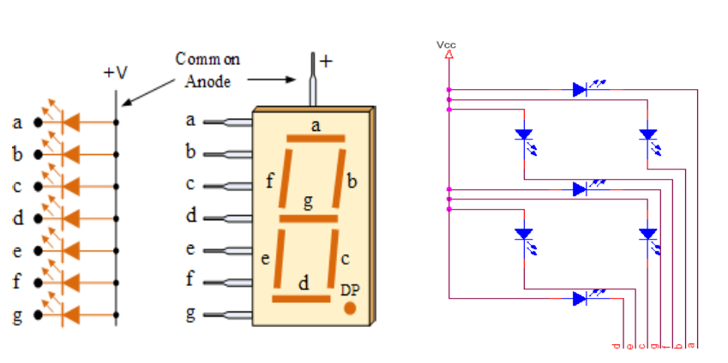
Common Anode SSD

Slide 12
Common Anode (CA)
In the common anode display, all the anode connections of the LED’s are joined together to logic “1” .
The individual segments are illuminated by connecting the individual Cathode terminals to a “LOW”, logic “0” signal.

Slide 13
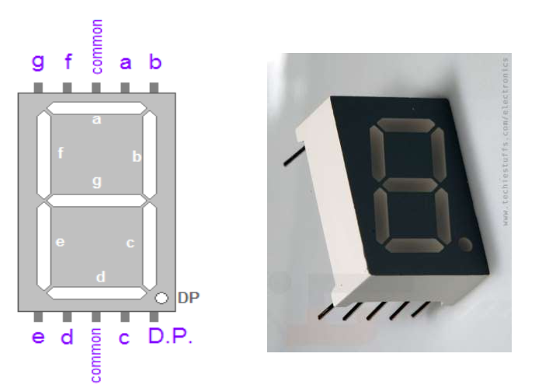
Pin Configuration of SSD

Slide 14
Driving 7 segment display using IC 4511

Slide 15
7-segment Displays are usually driven by a special type of integrated circuit (IC) like CMOS 4511. This 7-segment display driver is able to illuminate both common anode or common cathode displays.
This BCD-to-7 segment driver takes a four-bit BCD input and has outputs that will pass current through the segments to display the decimal digit.

Slide 16
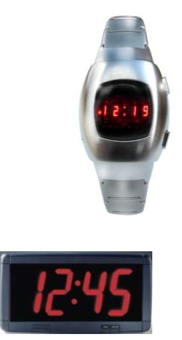
Applications
As Seven segment display provides a convenient way to display decimal numbers in digital form, it is helpful in general purpose devices and reduces the complexity of data delivered.
It is used in many devices of our day to day life, like in traffic signals, watches, cd/dvd players etc.

Slide 17
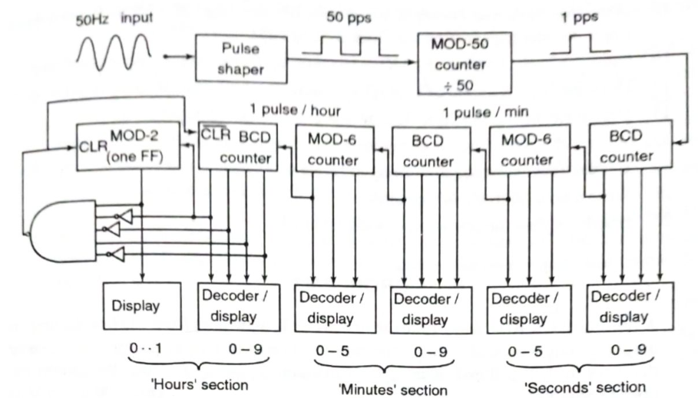
Digital Clock

Slide 18
Digital clock displays the time of day in hours, minutes and seconds.
DC power – Frequency obtained from quartz –crystal oscillator.
AC Power – Use power line frequency
50 Hz change to 1 Hz use by pulse shaper circuit and frequency divider.

Slide 19
Circuit Operation
Section | Digit Level | Counter | Display
Seconds | First | BCD | 0 – 9
 | Second | MOD 6 | 0-5
Minutes | First | BCD | 0 – 9
 | Second | MOD 6 | 0-5
Hours (Reset zero when reach count 12 by using NAND gate) | First | BCD | 0 – 9
 | Second | MOD 2 | 0-1

Slide 20
12-hour Digital Clock
Wave-
shaping
Circuit
50Hz
1 Hz
CTR DIV 10
CTR DIV 5
Q
CTR
DIV 10
CTR
DIV 6
CTR
DIV 10
CTR
DIV 6
CTR
DIV 10
FF
BCD/
7-SEG
BCD/
7-SEG
BCD/
7-SEG
BCD/
7-SEG
BCD/
7-SEG
BCD/
7-SEG
1
2
:
5
9
:
3
0
Notes:
20

Slide 21
Counter Applications – 60 seconds counter
We can design a 60-second counter (00-59) by cascading two 74LS93 counter ICs as shown:
0 TO 9 COUNTER, least significant digit
0 TO 5 COUNTER, most significant digit
+ 5V
+ 5V
Clock pulse
CP₀
V_{CC}
CP₀
V_{CC}
GND
GND
74LS93
74LS93
CP₁
CP₁
MR₁
MR₂
Q₃
Q₂
Q₁
Q₀
MR₁
MR₂
Q₃
Q₂
Q₁
Q₀
To seven segment LED display
To seven segment LED display
At clock 10, reset back to 0000₂; To achieve this, connect Q3 and Q1 to MR1 and MR2 to reset the counter when the counter goes to 1010₂
At clock 6, reset back to 0000₂; To achieve this, connect Q2 and Q1 to MR1 and MR2 to reset the counter when the counter goes to 0110₂
Reference: S. Salivahanan, S. Arivazhagan. “Digital circuits and design” Third edition – Vikas Publishing House Pvt Ltd
Notes:
21

